Slide 1
Python promotion tool
OMS and Streamics

Slide 2
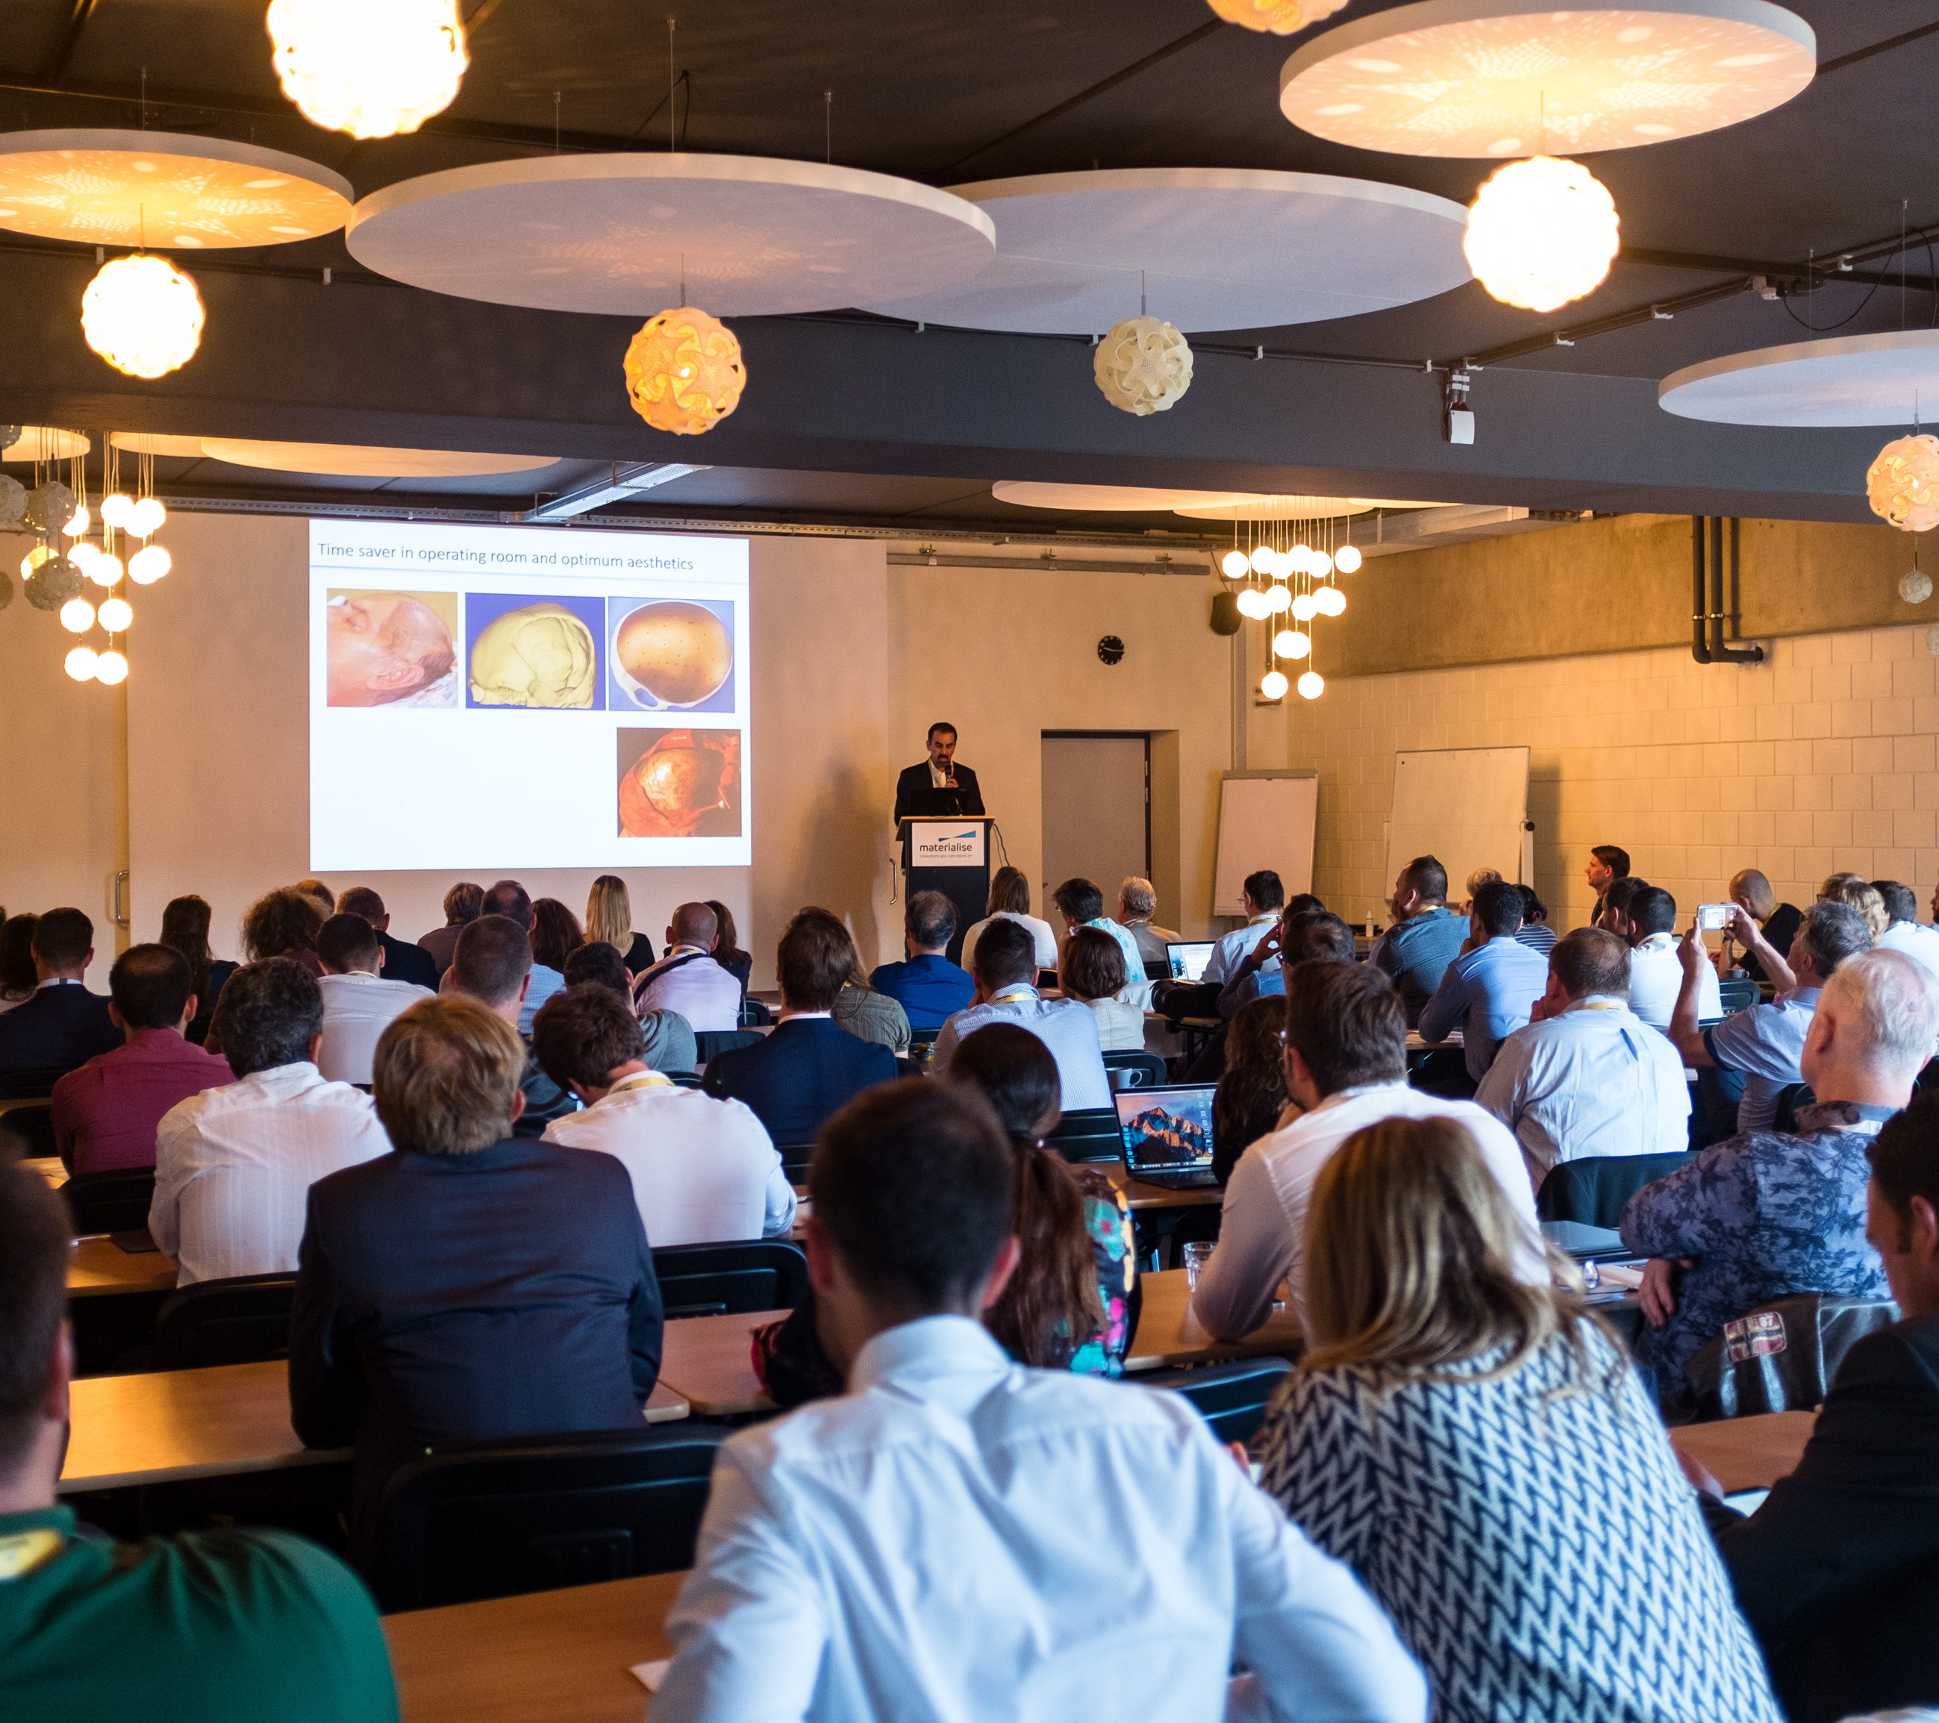
Content
[1] Current OMS flow
[2] Streamics
[3] Order ID versus Case ID
[4] Manual workflow Streamics post-processing
Promotion of order
Scrapping a printed part
[5] Automated workflow Streamics post-processing
[6] Future

Slide 3
OMS flow

Slide 4
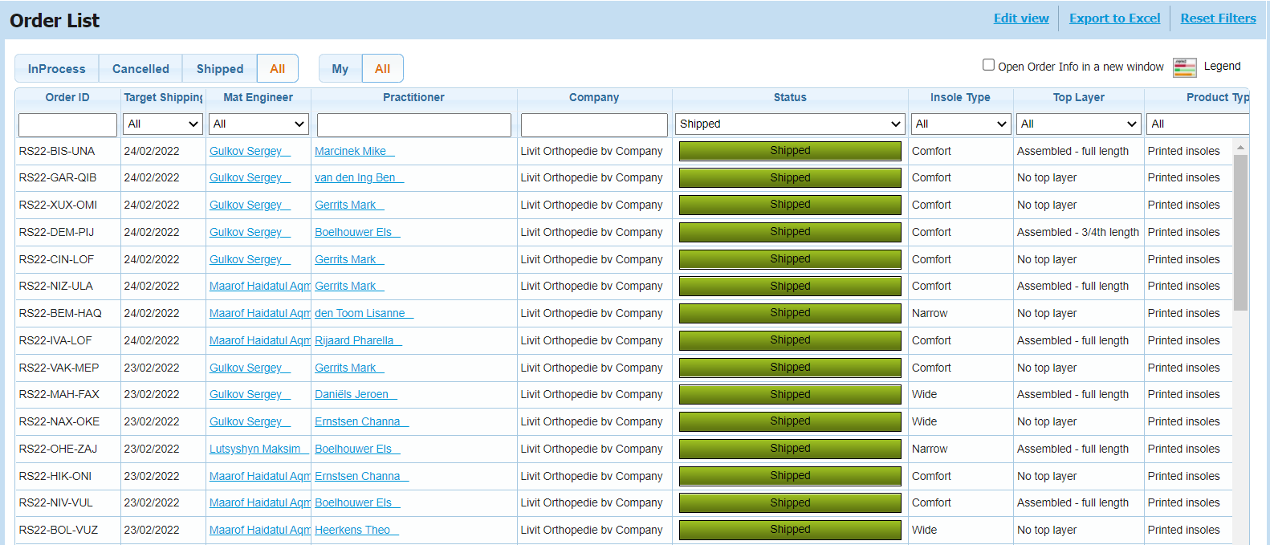
OMS order database

Slide 5
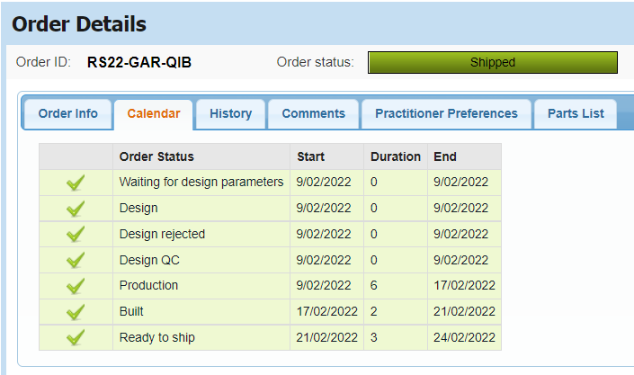
OMS order database
Materialise HQ
Motion

Slide 6
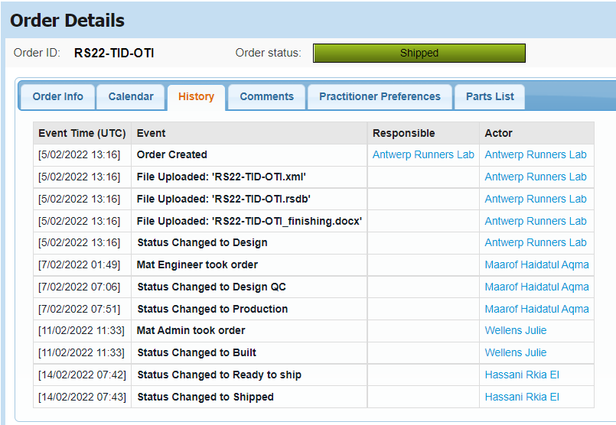
OMS order database
Materialise HQ
Motion

Slide 7
Bottlenecks
Limited traceability on production steps of Materialise HQ
Click click click..

Slide 8
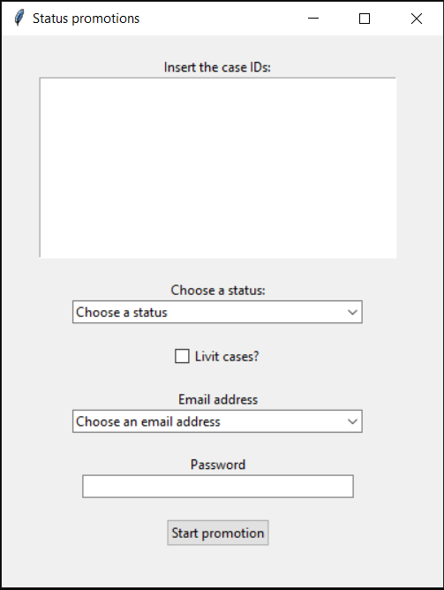
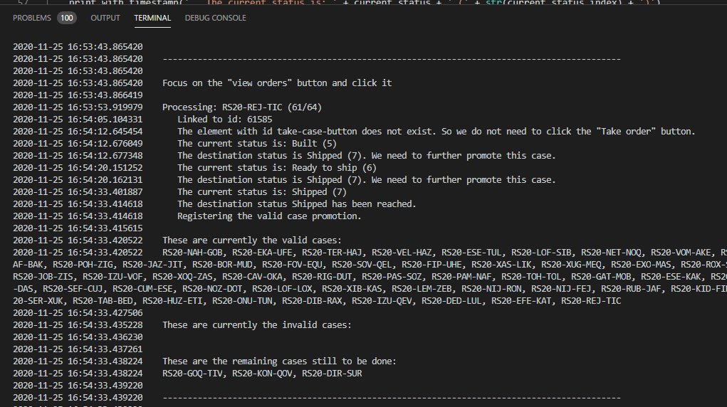
Python automation tool

Slide 9
Streamics

Slide 10
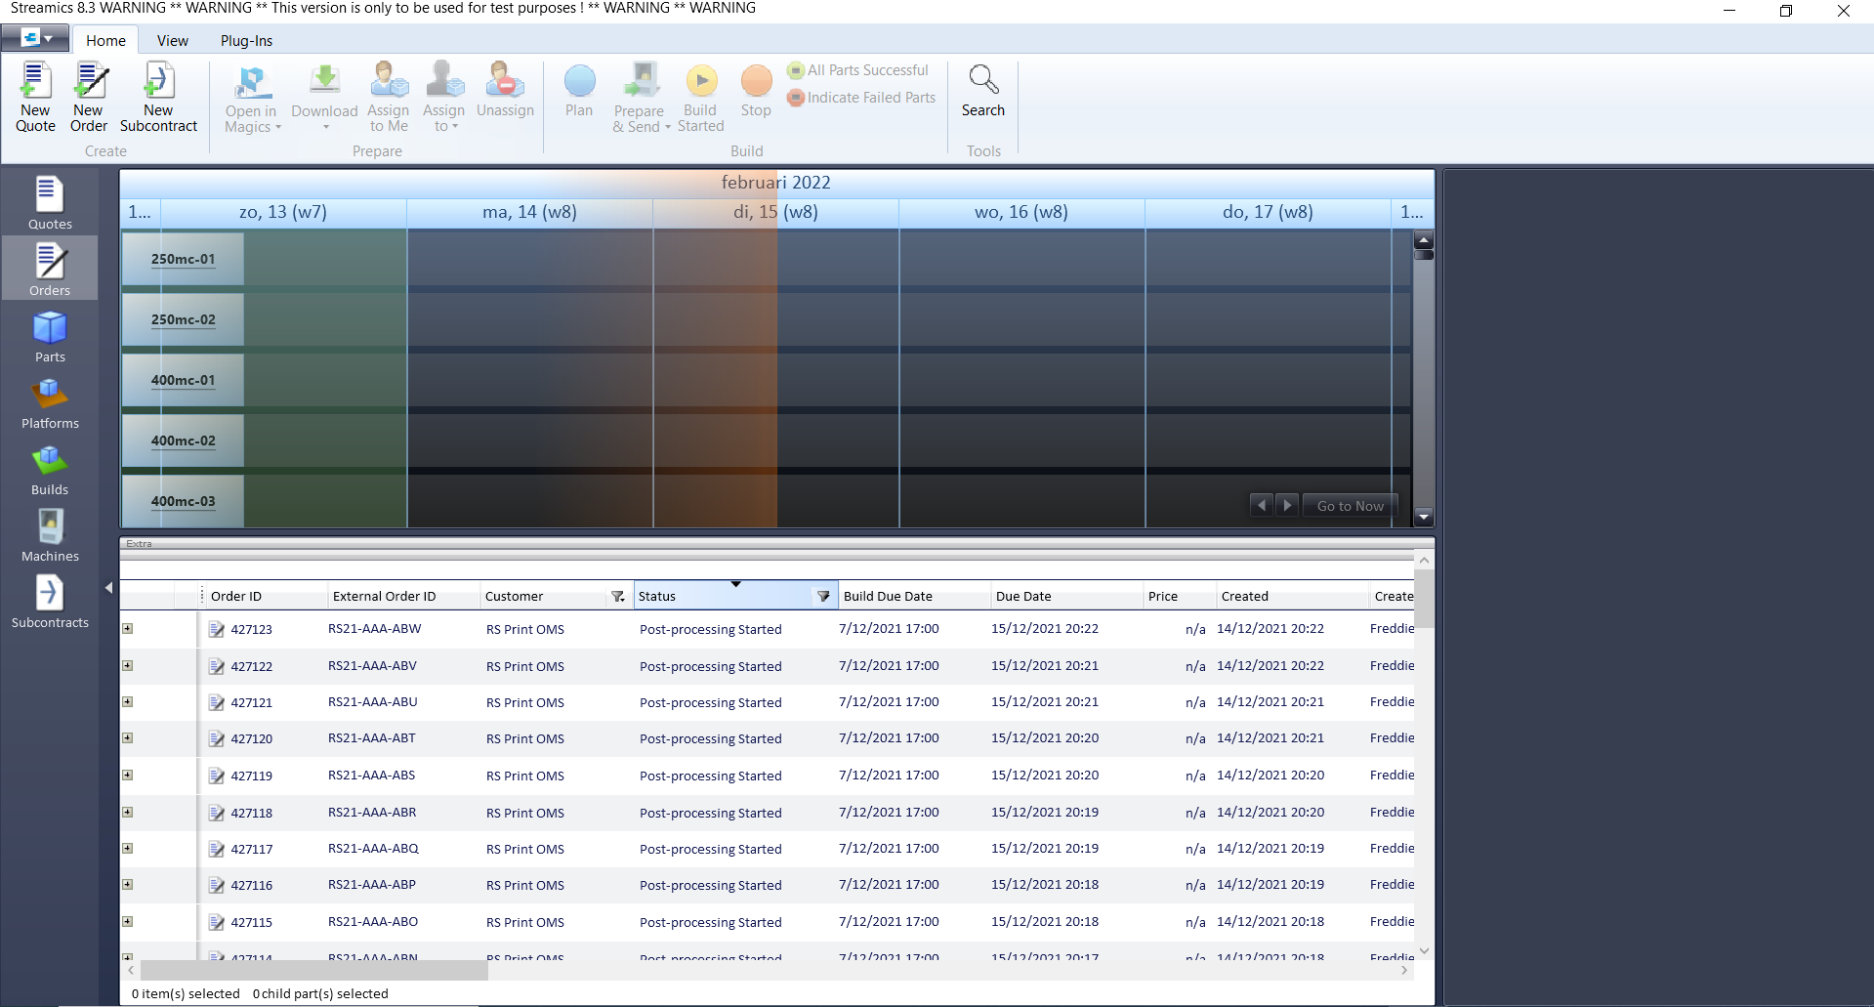
Manufacturing and post-processing software

Slide 11
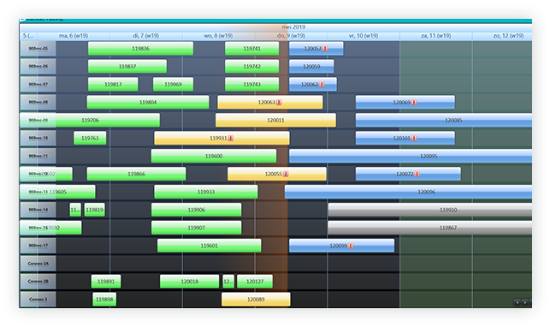
Manufacturing and post-processing software

Slide 12
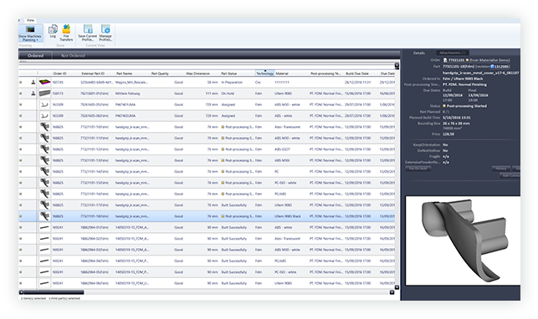
Manufacturing and post-processing software

Slide 13
Good to know
We need to promote cases in both the OMS and Streamics from now on.

Slide 14
Order ID versus Case ID

Slide 15
Order ID <> Case ID

Slide 16
Order ID <> Case ID
Order ID:
Unique internal production number of Streamics
(i.e. a number with no meaning)
External order ID:
= Case ID
Unique internal code of the insoles/OMS
(i.e. alternate key)
Customer:
RS Print OMS

Slide 17
Login Streamics

Slide 18
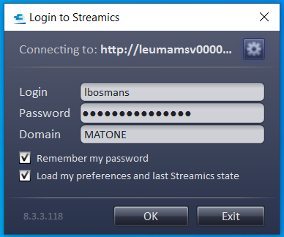
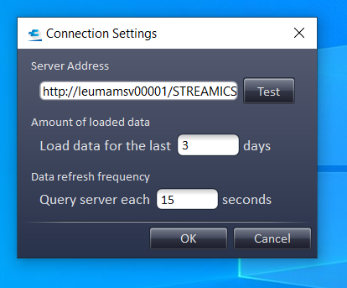
Login desktop application
http://leumamsp00001/STREAMICS/server.svc

Slide 19
Login desktop application
Login option 1:
firstname.lastname@materialise.be
Login option 2:
Abbreviation of name (first letter first name + last name)
Password:
Personal password Materialise
Tip:
Use the same password for both:
OMS
Streamics

Slide 20
Login desktop application

Slide 21
Login Streamics post-processing

Slide 22
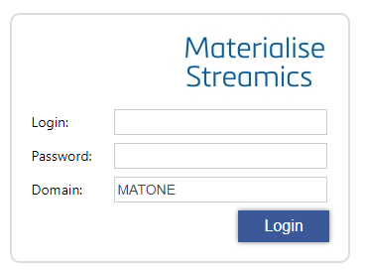
Login web application: post-processing
Login option 1:
firstname.lastname@materialise.be
Login option 2:
Abbreviation of name (first letter first name + last name)
Password:
Personal password Materialise
Tip:
Use the same password for both:
OMS
Streamics
http://leumamsp00001/STREAMICS/PostProcessing

Slide 23
Manual workflow Streamics promotion

Slide 24

Good to know
Promoting an order manually requires the order ID.
We will scan the order ID with a QR code.
The QR codes can be generated with a second script if necessary.

Slide 25
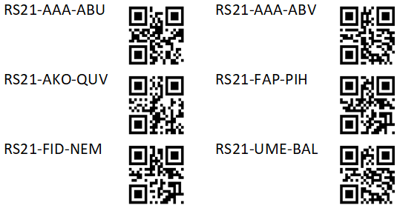
Good to know
The QR code will represent the order ID. The case ID is written next to it.
The order ID has a prefix ‘ord’
E.g.: ord427058

Slide 26
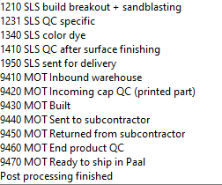
Statuses
OMS
Streamics
Materialise HQ
Motion

Slide 27
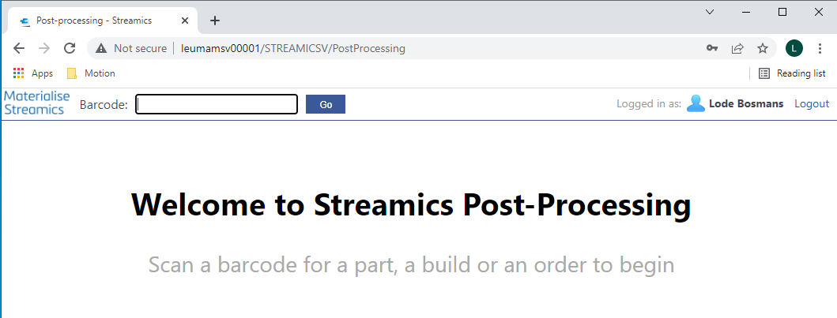
Web application: start screen

Slide 28
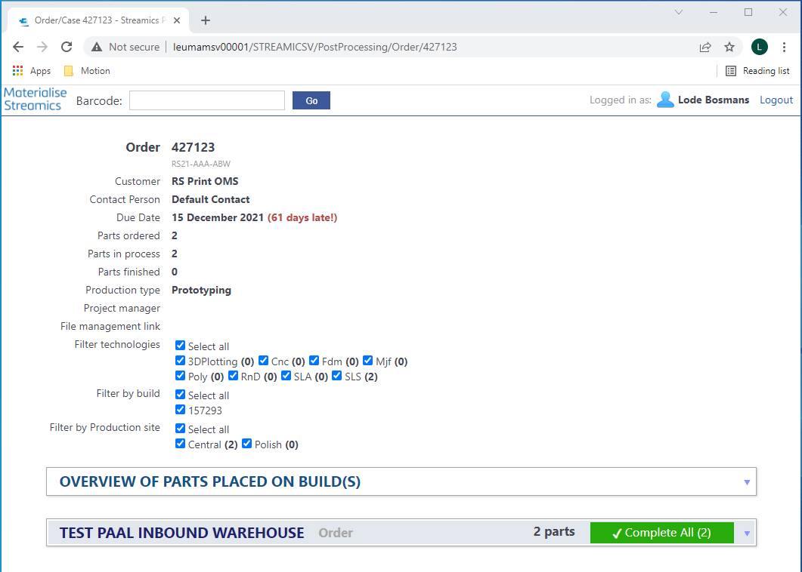
Order page: overview
General info
Parts
Statuses

Slide 29
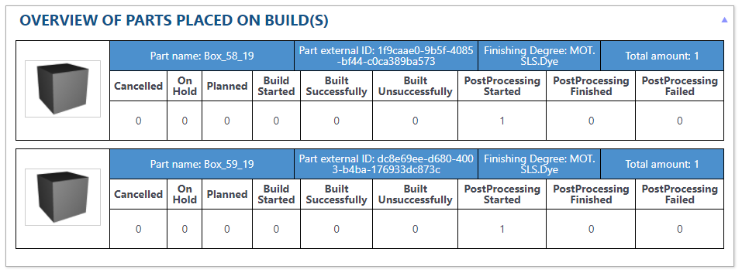
Order page: parts in production
Materialise HQ
Motion

Slide 30
Order page: overview
General info
Parts
Statuses

Slide 31
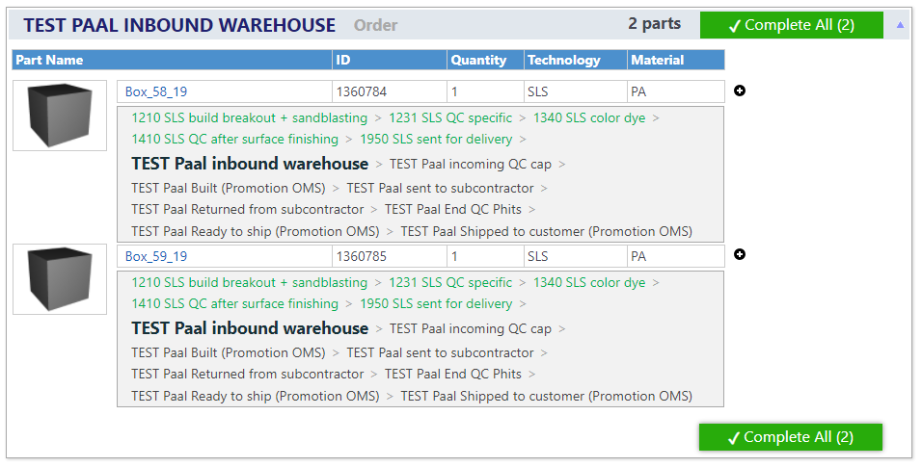
Order page: post-processing statuses

Slide 32
Order page: promotion

Slide 33
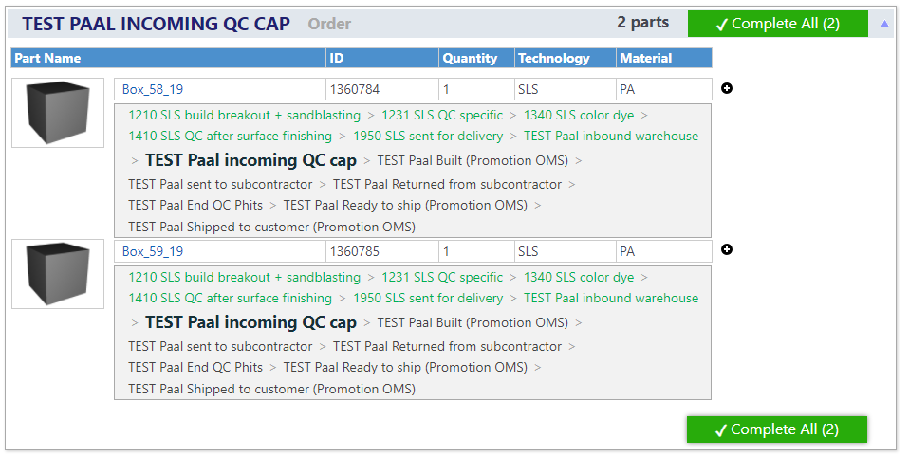
Order page: promotion

Slide 34

Order page: promotion

Slide 35
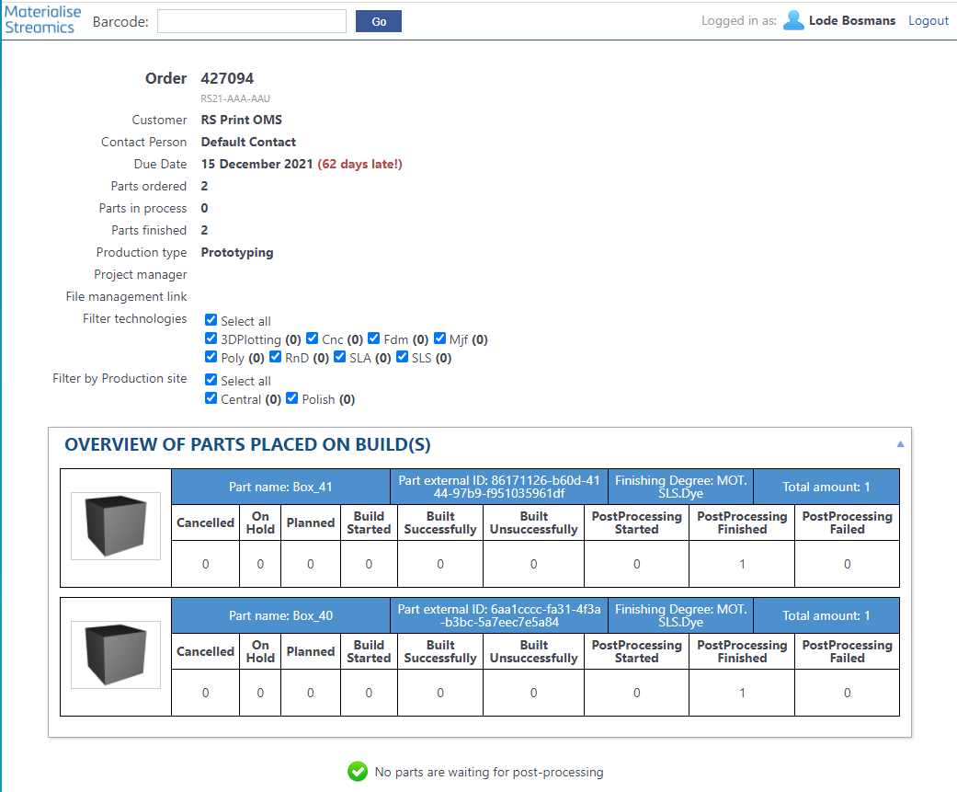
Order page: post-processing finished

Slide 36
Manual workflow Streamics scrap

Slide 37
Good to know
Scrapping an order manually order requires the order ID.
Scrapping a part = automatically requesting a new reprint from MTLS production
No more mailing to the planners of MTLS production
Reprints still need to be logged on the server!

Slide 38
Web application: start screen

Slide 39
Order page: scrapping a part

Slide 40
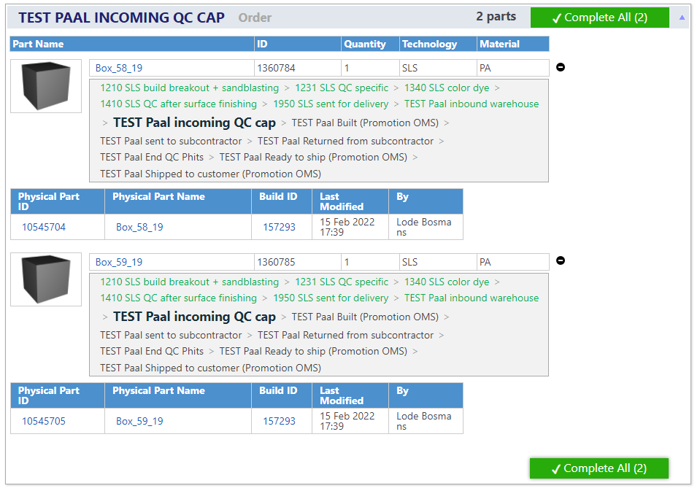
Order page: scrapping a part

Slide 41
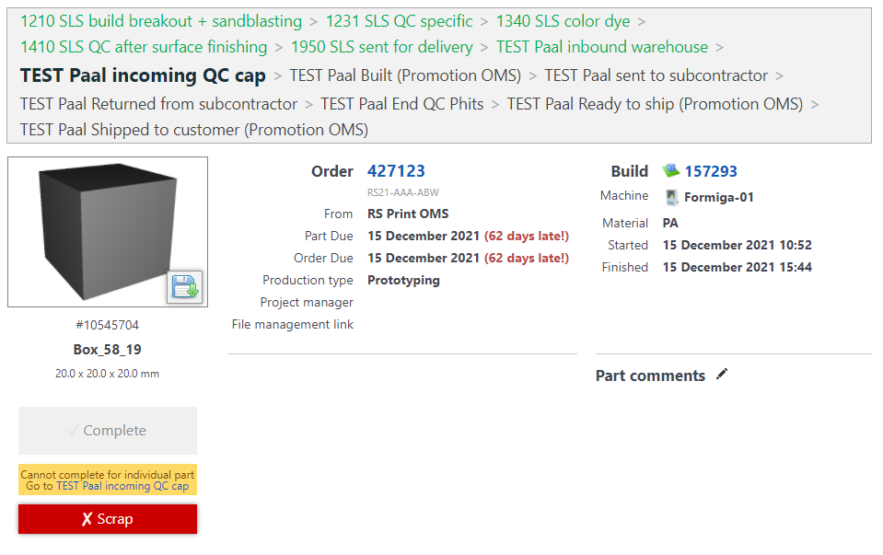
Order page: scrapping a part

Slide 42
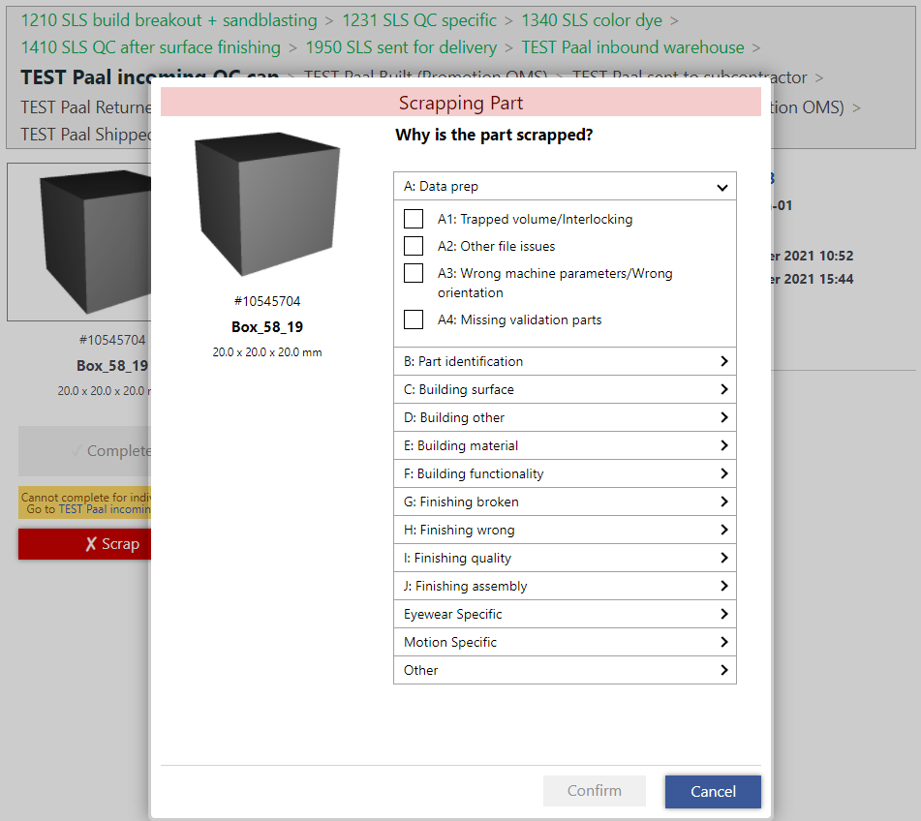
Order page: scrapping a part

Slide 43
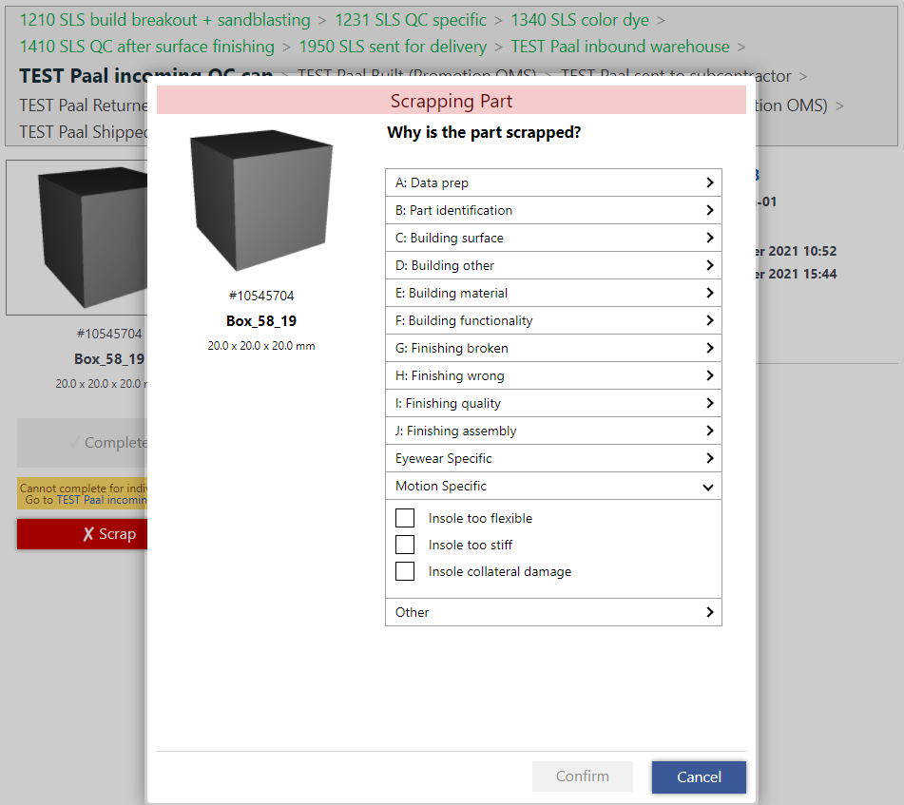
Order page: scrapping a part

Slide 44
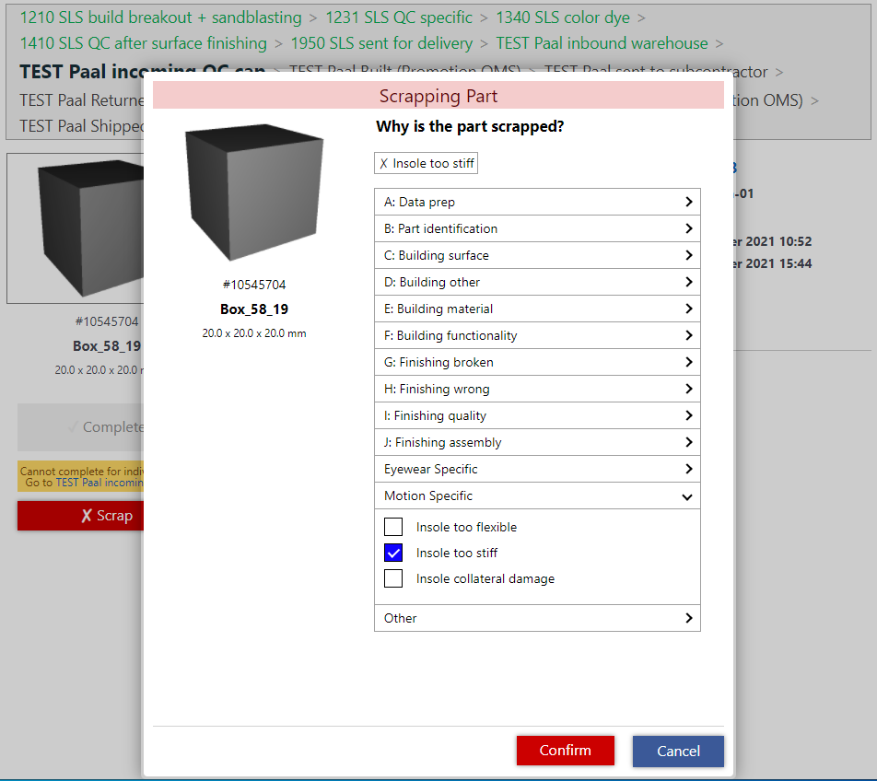
Order page: scrapping a part

Slide 45
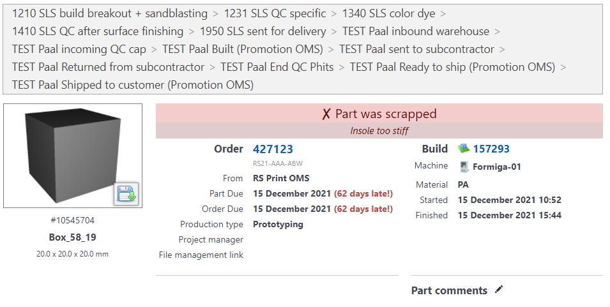
Order page: scrapping a part

Slide 46
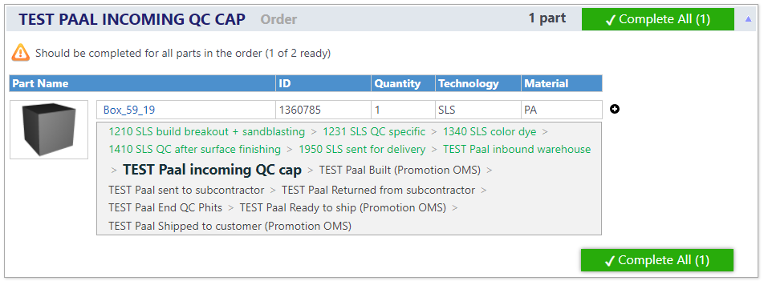
Order page: scrapping a part

Slide 47
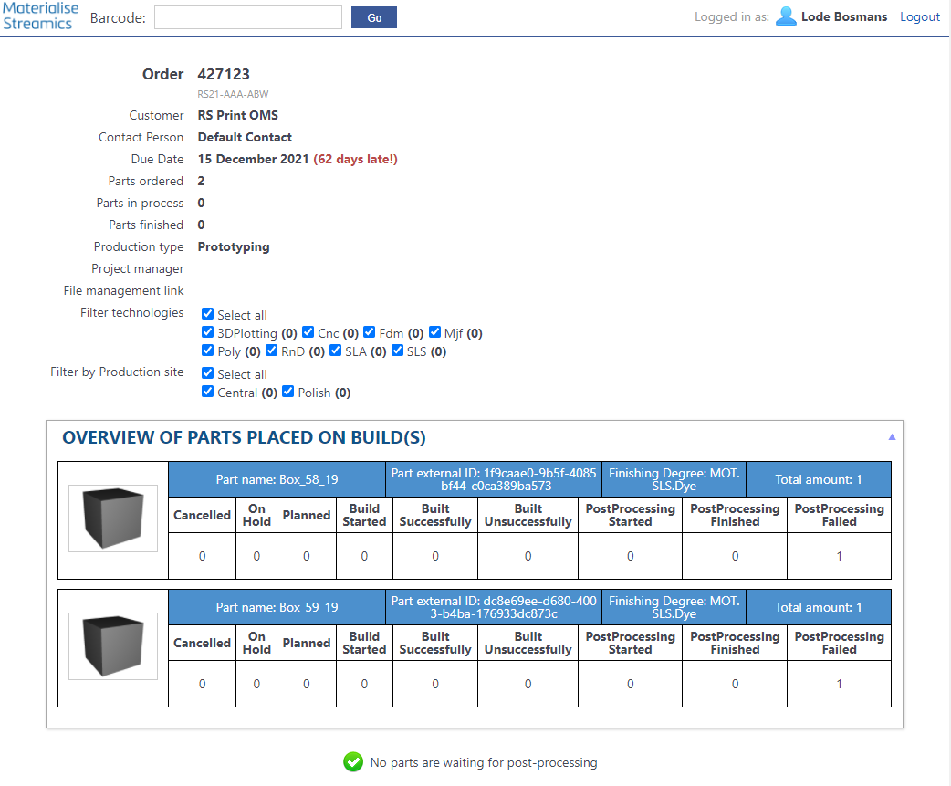
Order page: scrapping a part

Slide 48
Try-out manual process

Slide 49
Automated workflow Streamics

Slide 50
Good to know
The automation tool uses case IDs! Order IDs are synced in the background.
The automated flow promotes cases in both the OMS and Streamics.
The Streamics promotions can be disabled if desired (for US promotions).
Chromedriver needs updates from time to time.
The automation tool can run in multiple instances in parallel.
If the script fails, restart it completely with the same input.

Slide 51
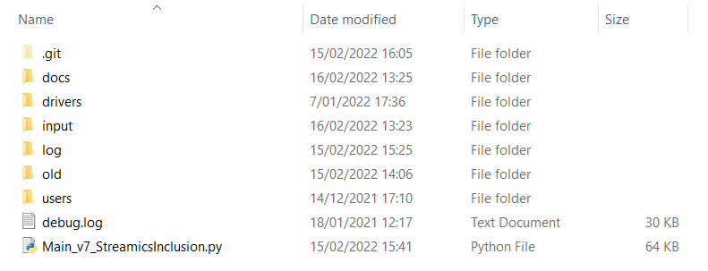
Files

Slide 52
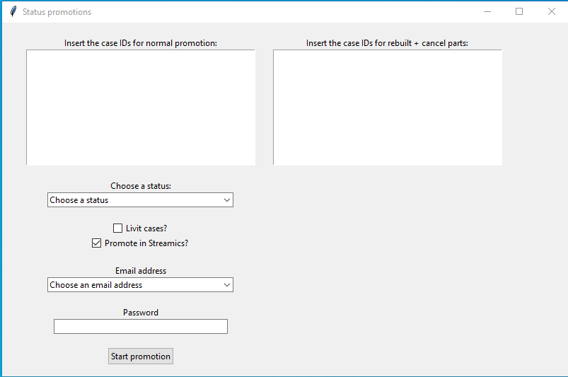
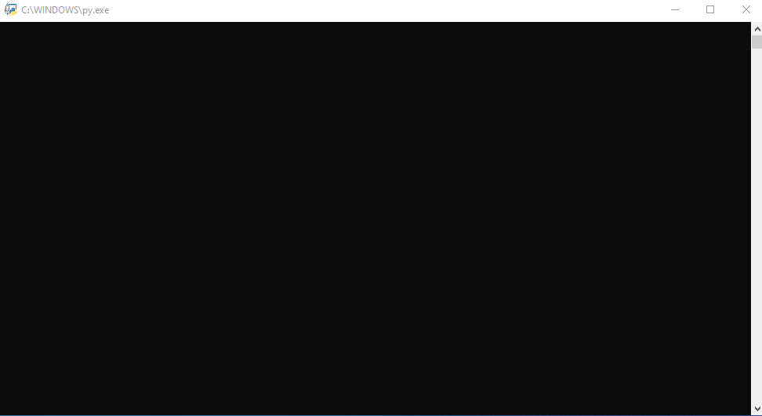
Interface
Input interface
Output terminal

Slide 53

Interface

Slide 54
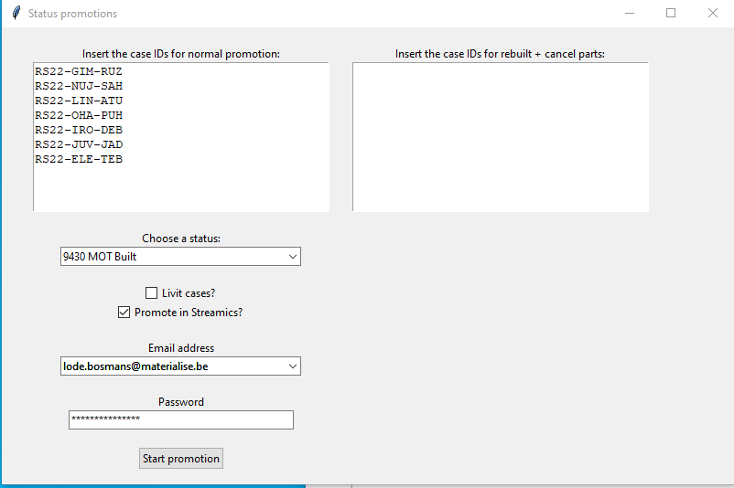
Interface

Slide 55
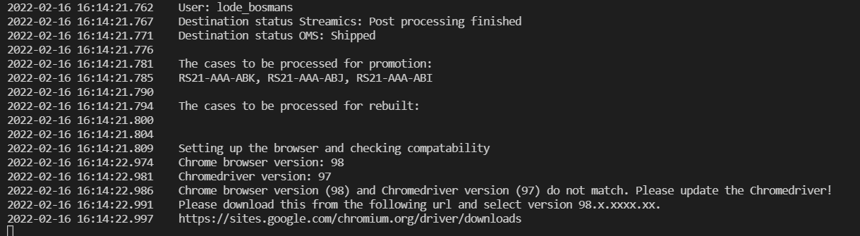
Chromedriver version
Place the updated Chromedriver in the folder ‘drivers’
https://sites.google.com/chromium.org/driver/downloads

Slide 56
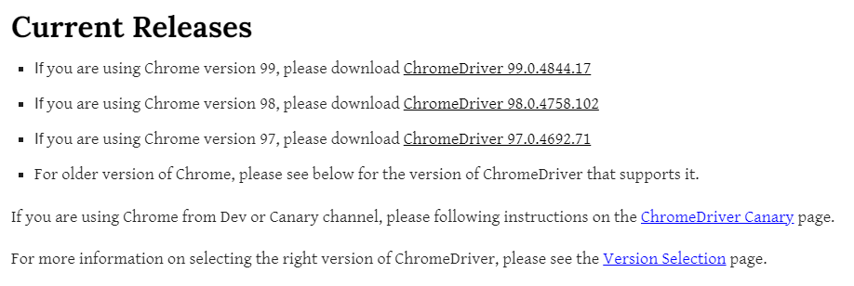
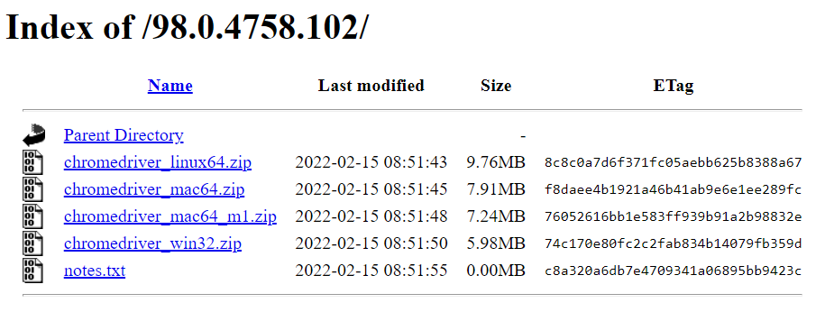
Chromedriver version

Slide 57
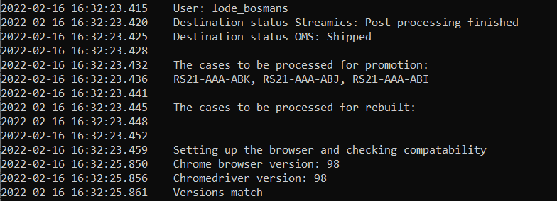
Chromedriver version

Slide 58
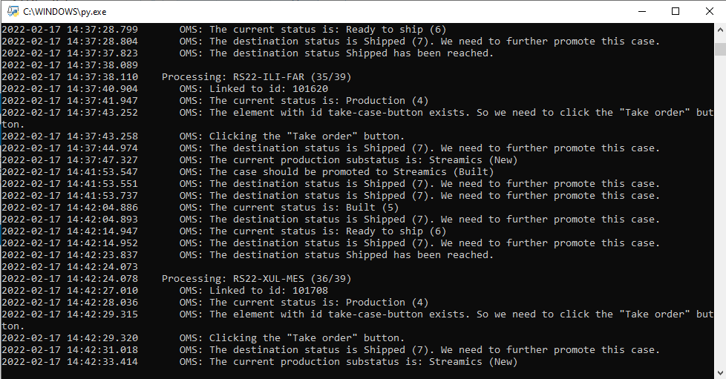
Run in parallel

Slide 59
Run in parallel
Best practices
Divide the amount of cases (e.g. 100) by a self defined number X (e.g. 5)
This will create X (e.g. 5) subsets of Y (e.g. 20) amount of cases
Start up X (e.g. 5) parallel promotion tools with Y (e.g. 20) amount of cases
Never run a case in multiple promotion tools (small risk for conflicts)

Slide 60
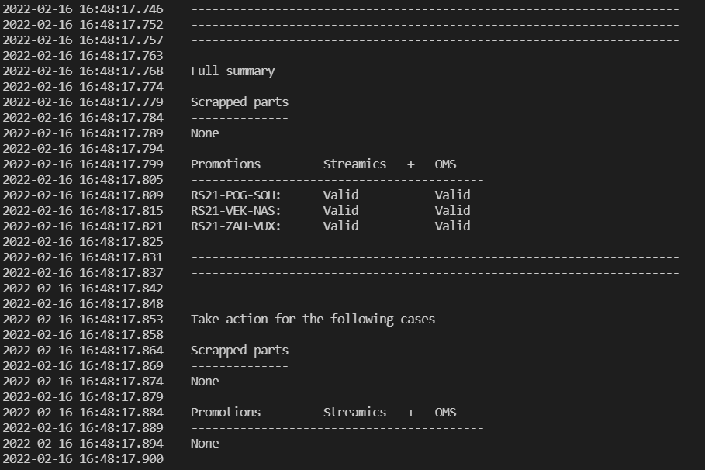
Terminal summary: verify outcome !!!!

Slide 61
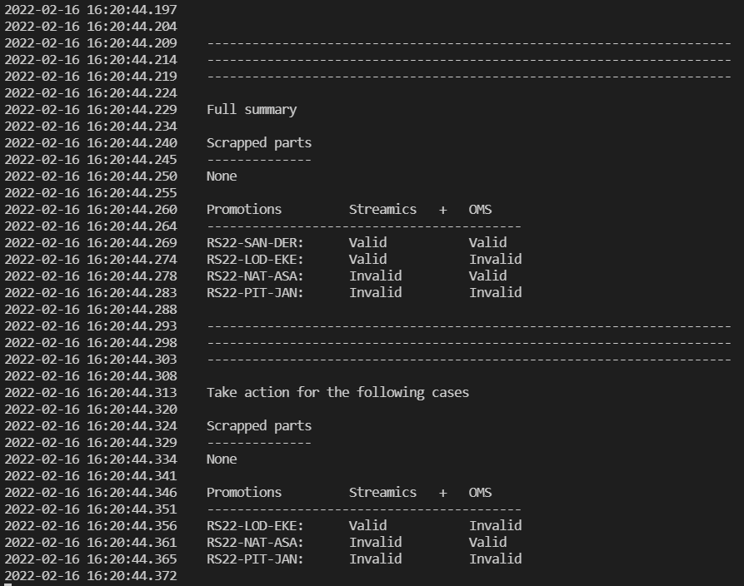
Terminal summary: verify outcome !!!!

Slide 62
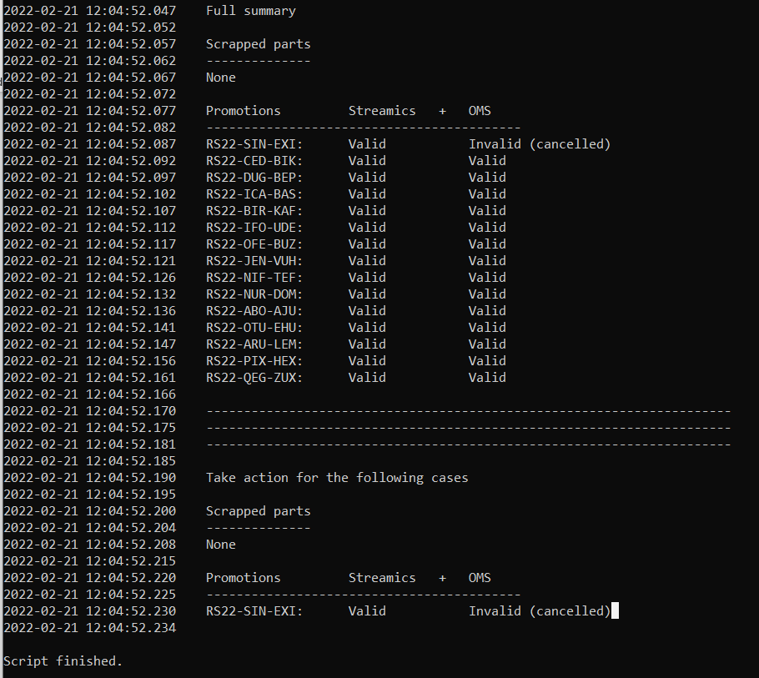
Terminal summary: verify outcome !!!!

Slide 63
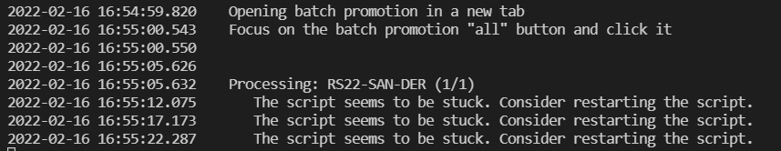
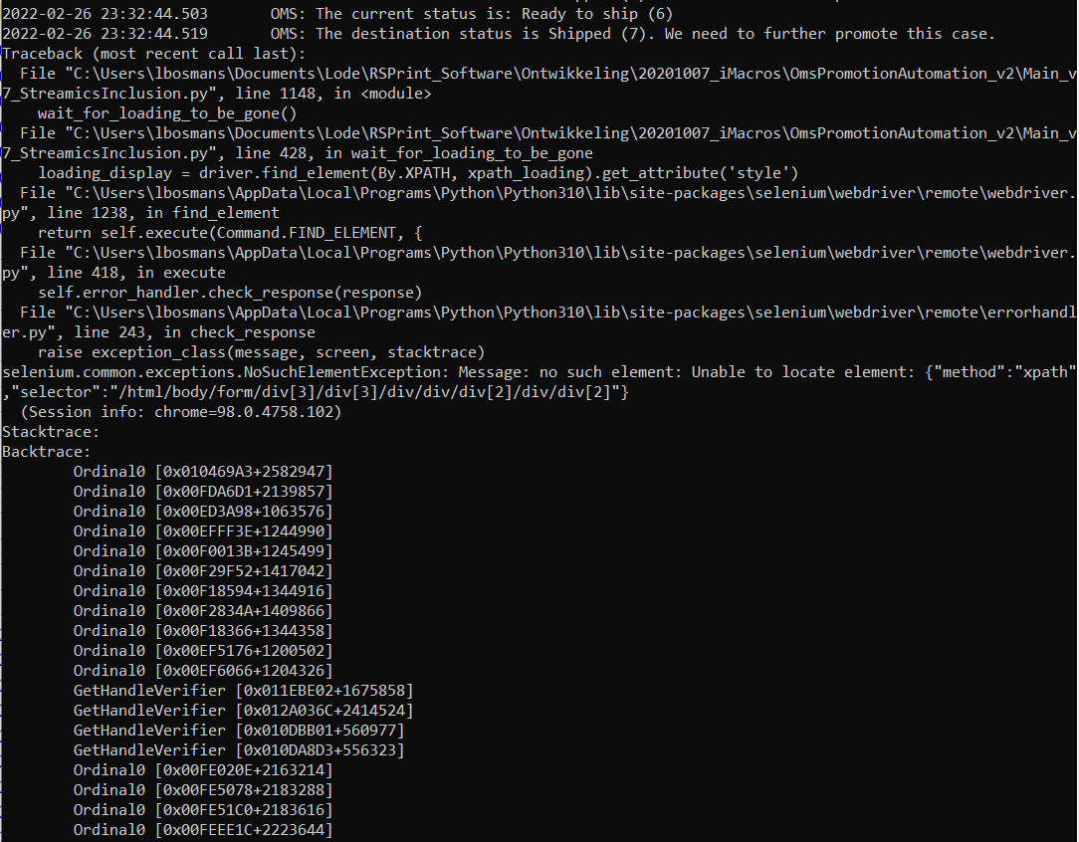
Failure
Add pathway and object example

Slide 64
Automated workflow Streamics scrap

Slide 65
Good to know
We didn’t automate this step, to avoid making errors on automated pilot.
We don’t have the order ID available with a QR code, so we need to fetch it from Streamics. Or you can generate it with the second script.
Reprints still need to be logged on the server!
Same workflow as the manual workflow.

Slide 66
Streamics

Slide 67
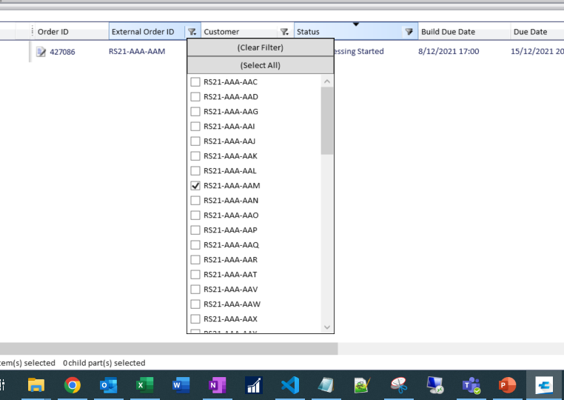
Streamics

Slide 68
Try-out automated process

Slide 69
Quiz

Slide 70
Kahoot.it

Slide 71
Question 1:
Which ID is entered in Streamics post-processing?
Case ID
Order ID

Slide 72
Question 2:
Which ID is used in the automated flow?
Case ID
Order ID

Slide 73
Question 3:
Which item does not belong in the list?
Scrapping an order
Automatic reprint
No more logging
No more mailing

Slide 74
Future

Slide 75
Other system?

Slide 76

Questions?

